Slide 1
IEEE 802.11 Wireless LAN Standard
Chapter 9

Slide 2
Protocol Architecture

Slide 3
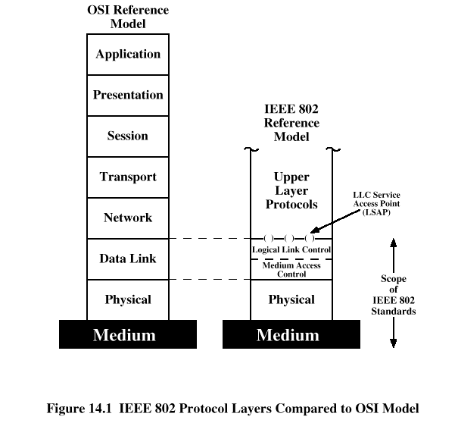
IEEE 802 Protocol Layers

Slide 4
Protocol Architecture
Functions of physical layer:
  Encoding/decoding of signals
  Preamble generation/removal (for synchronization)
  Bit transmission/reception
  Includes specification of the transmission medium

Slide 5
Protocol Architecture
Functions of medium access control (MAC) layer:
  On transmission, assemble data into a frame with address and error detection fields
  On reception, disassemble frame and perform address recognition and error detection
  Govern access to the LAN transmission medium
Functions of logical link control (LLC) Layer:
  Provide an interface to higher layers and perform flow and error control

Slide 6
Separation of LLC and MAC
The logic required to manage access to a shared-access medium not found in traditional layer 2 data link control
For the same LLC, several MAC options may be provided

Slide 7
MAC Frame Format
MAC control
  Contains Mac protocol information
Destination MAC address
  Destination physical attachment point
Source MAC address
  Source physical attachment point
CRC
  Cyclic redundancy check

Slide 8
Logical Link Control
Characteristics of LLC not shared by other control protocols:
  Must support multiaccess, shared-medium nature of the link
  Relieved of some details of link access by MAC layer

Slide 9
LLC Services
Unacknowledged connectionless service
  No flow- and error-control mechanisms
  Data delivery not guaranteed
Connection-mode service
  Logical connection set up between two users
  Flow- and error-control provided
Acknowledged connectionless service
  Cross between previous two
  Datagrams acknowledged
  No prior logical setup

Slide 10
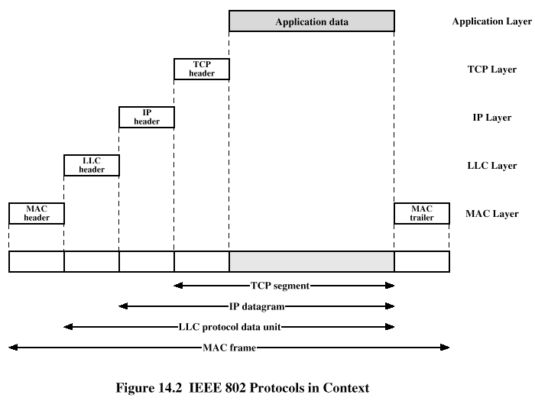
IEEE 802.11 Services

Slide 11
Architecture

Slide 12
IEEE 802.11 Architecture
Distribution system (DS)
Access point (AP)
Basic service set (BSS)
  Stations competing for access to shared wireless medium
  Isolated or connected to backbone DS through AP
Extended service set (ESS)
  Two or more basic service sets interconnected by DS
See figure 14.4

Slide 13
Distribution of Messages Within a DS
Distribution service
  Used to exchange MAC frames from station in one BSS to station in another BSS
Integration service
  Transfer of data between station on IEEE 802.11 LAN and station on integrated IEEE 802.x LAN

Slide 14
Transition Types Based On Mobility
No transition
  Stationary or moves only within BSS
BSS transition
  Station moving from one BSS to another BSS in same ESS
ESS transition
  Station moving from BSS in one ESS to BSS within another ESS

Slide 15
Association-Related Services
Association
  Establishes initial association between station and AP
Reassociation
  Enables transfer of association from one AP to another, allowing station to move from one BSS to another
Disassociation
  Association termination notice from station or AP

Slide 16
Access and Privacy Services
Authentication
  Establishes identity of stations to each other
Deathentication
  Invoked when existing authentication is terminated
Privacy
  Prevents message contents from being read by unintended recipient

Slide 17
Medium Access Control

Slide 18
IEEE 802.11 Medium Access Control
MAC layer covers three functional areas:
  Reliable data delivery
  Access control
  Security

Slide 19
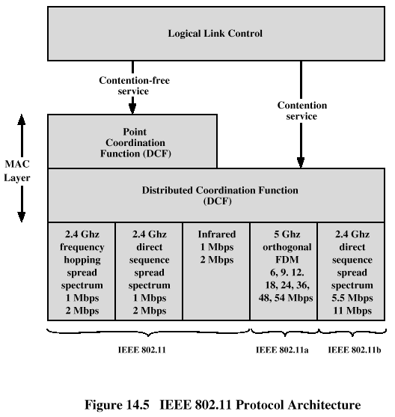
Access Control
(PCF)

Slide 20
Reliable Data Delivery
More efficient to deal with errors at the MAC level than higher layer (such as TCP)
Frame exchange protocol
  Source station transmits data
  Destination responds with acknowledgment (ACK)
  If source doesn’t receive ACK, it retransmits frame
Four frame exchange
  Source issues request to send (RTS)
  Destination responds with clear to send (CTS)
  Source transmits data
  Destination responds with ACK

Slide 21
Reliable Data Delivery
Two types of medium access methods:
  Point Coordination Function
    A centralized, contention-free polling access method
    Implemented in an infrastructure network (not in ad hoc network), mostly for time-sensitive transmission
  Distributed Coordination Function
    Uses a contention algorithm (CSMA/CA method) to provide access (see figure 14.6 and figure 14.7).

Slide 22
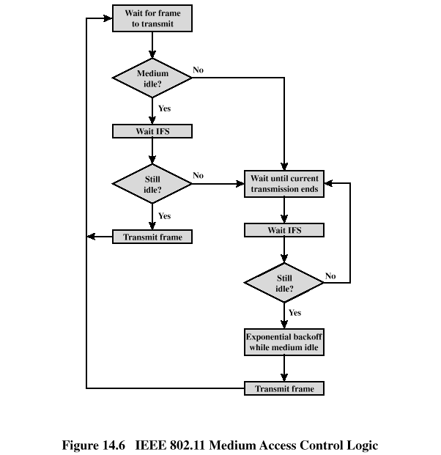
  Distributed Coordination Function: Medium Access Control
  based on CSMA/CA
Backoff (BO): the station draws a random number based on exponential distribution and sets the backoff timer

Slide 23
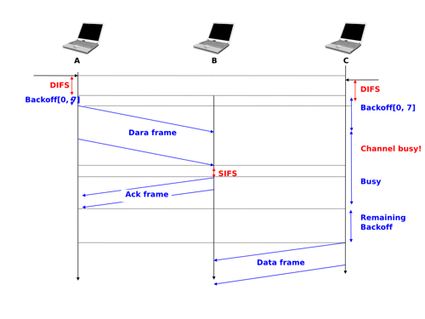
Medium Access Control Logic (cont’d)
Backoff timer - only counts when the channel is idle (stops when busy and resumes when clear

Slide 24
Interframe Space (IFS) Values
Short IFS (SIFS)
  Shortest IFS
  Used for immediate response actions
Point coordination function IFS (PIFS)
  Midlength IFS
  Used by centralized controller in PCF scheme when using polls
Distributed coordination function IFS (DIFS)
  Longest IFS
  Used as minimum delay of asynchronous frames contending for access

Slide 25
IFS Usage
SIFS
  Acknowledgment (ACK)
  Clear to send (CTS)
  Poll response
PIFS
  Used by centralized controller in issuing polls
  Takes precedence over normal contention traffic
DIFS
  Used for all ordinary asynchronous traffic

Slide 26
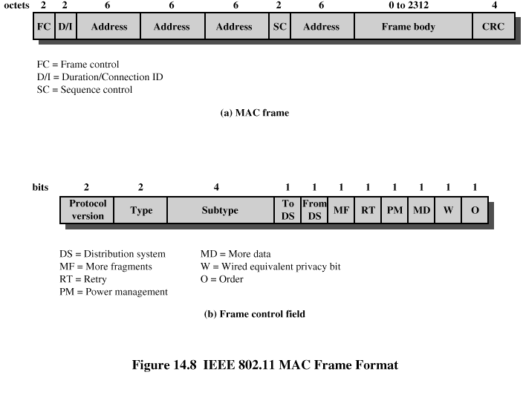
MAC Frame Format

Slide 27
MAC Frame Fields
Frame Control – frame type, control information
Duration/connection ID – channel allocation time
Addresses – context dependant, types include source and destination
Sequence control – numbering and reassembly
Frame body – MSDU or fragment of MSDU
Frame check sequence – 32-bit CRC

Slide 28
Frame Control Fields
Protocol version – 802.11 version
Type – control, management, or data
Subtype – identifies function of frame
To DS – 1 if destined for DS
From DS – 1 if leaving DS
More fragments – 1 if fragments follow
Retry – 1 if retransmission of previous frame

Slide 29
Frame Control Fields
Power management – 1 if transmitting station is in sleep mode
More data – Indicates that station has more data to send
WEP – 1 if wired equivalent protocol is implemented
Order – 1 if any data frame is sent using the Strictly Ordered service

Slide 30
Frame Control Fields – addressing mechanism
The following table show the interpretation of the address values in the MAC frame
To DS | From DS | Address 1 | Address 2 | Address 3 | Address 4
0 | 0 | Destination | Source | BSS ID | N/A
0 | 1 | Destination | Sending AP | Source | N/A
1 | 0 | Receiving AP | Source | Destination | N/A
1 | 1 | Receiving AP | Sending AP | Destination | Source

Slide 31
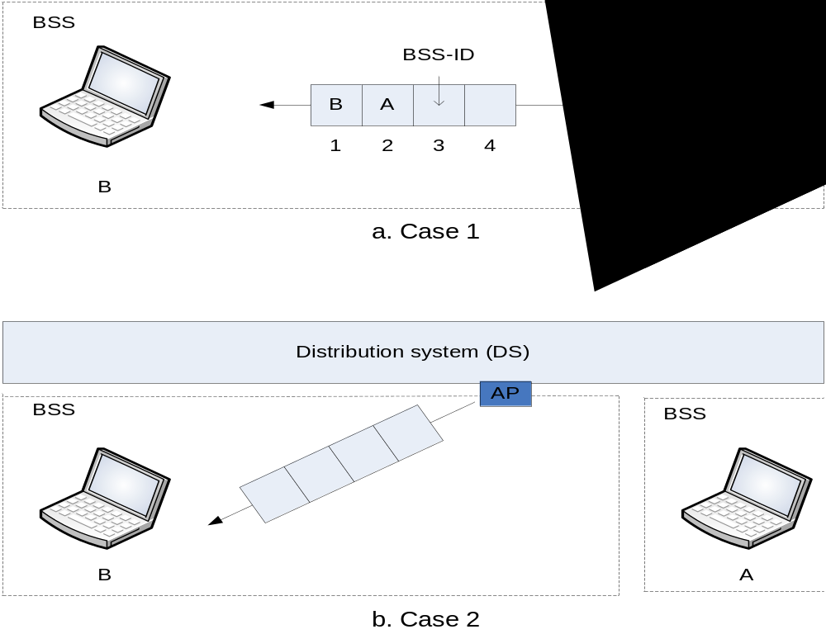
Frame Control Fields – addressing mechanism (cont’d)

Slide 32
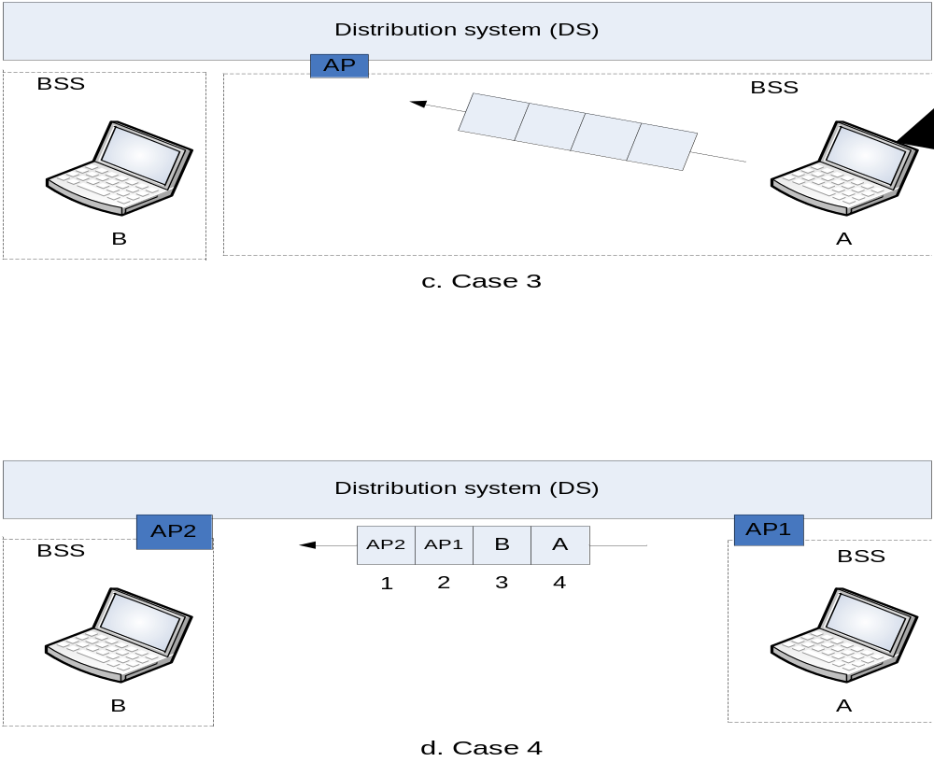
Frame Control Fields – addressing mechanism (cont’d)

Slide 33
Control Frame Subtypes
Power save – poll (PS-Poll)
Request to send (RTS)
Clear to send (CTS)
Acknowledgment
Contention-free (CF)-end
CF-end + CF-ack

Slide 34
Data Frame Subtypes
Data-carrying frames
  Data
  Data + CF-Ack
  Data + CF-Poll
  Data + CF-Ack + CF-Poll
Other subtypes (don’t carry user data)
  Null Function
  CF-Ack
  CF-Poll
  CF-Ack + CF-Poll

Slide 35
Management Frame Subtypes
Association request
Association response
Reassociation request
Reassociation response
Probe request
Probe response
Beacon

Slide 36
Management Frame Subtypes
Announcement traffic indication message
Dissociation
Authentication
Deauthentication

Slide 37
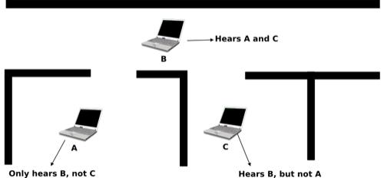
Hidden Station Problem in 802.11
Consider the following:
  Stations A and C are within the transmission range of B. But A and C are not in each other’s range. Therefore, message from A to B cannot reach C. And C thinks the medium is free and sends data to B, which results in collision at B.

Slide 38
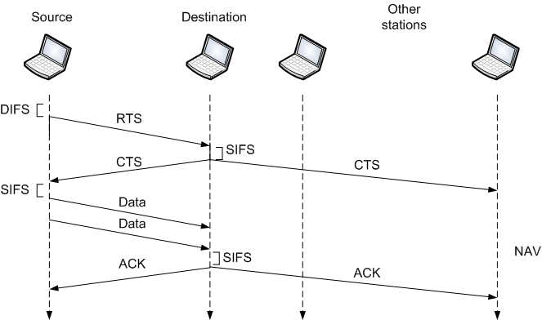
Hidden Station Problem un 802.11 (Solution)
Solution: handshaking using RTS, CTS

Slide 39
Physical Layer

Slide 40
IEEE802.11 Physical Layer
IEEE | Technique | Band | Modulation | Rate (Mbps)
802.11 | FHSS | 2.400-4.835 Ghz | FSK | 1 and 2
 | DSSS | 2.400-4.835 Ghz | PSK | 1 and 2
 | None | Infrared | PPM | 1 and 2
802.11a | OFDM | 5.725-5.850 Ghz | PSK or QAM | 6 to 54
802.11b | DSSS | 2.400-4.835 Ghz | PSK | 5.5 and 11
802.11g | OFDM | 2.400-4.835 Ghz | Different** | 22 and 54
802.11n | OFDM | 5.725-5.850 Ghz | Different | 600
*2.400-4.835 Ghz and 5.725-5.850 Ghz are ISM bands
**different modulation schemes are used according to the operation modes

Slide 41
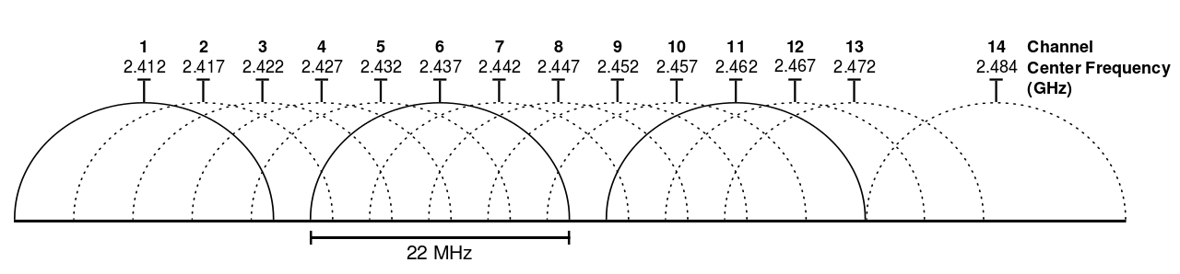
Frequency allocation
802.11 b/g channels in 2.4 GHz band

Slide 42
IEEE 802.11a and IEEE 802.11b
IEEE 802.11a
  Makes use of 5-GHz band
  Provides rates of 6, 9 , 12, 18, 24, 36, 48, 54 Mbps
  Uses orthogonal frequency division multiplexing (OFDM)
  Subcarrier modulated using BPSK, QPSK, 16-QAM or 64-QAM
IEEE 802.11b
  Provides data rates of 5.5 and 11 Mbps
  Complementary code keying (CCK) modulation scheme

Slide 43
IEEE 802.11g and IEEE 802.11n
IEEE 802.11g
  Provides rates of 22, 54 Mbps
  Uses orthogonal frequency division multiplexing (OFDM)
  Backward-compatible with 802.11b
IEEE 802.11n
  Uses MIMO (multiple-input-multiple-output) to overcome the noise problem
  600 Mbps

Slide 44
IEEE 802.11ac and IEEE 802.11ad
IEEE 802.11ac
  Rate of 500 Mbps
  4 X bandwidth (80 MHz)
  MIMO (with 8 spatial streams), multiuser-MIMO
  256-QAM
IEEE 802.11ad
  Uses the 60 GHz frequency band
  Up to 7 Gbps
  Short-range (e.g. single-room)

Slide 45
Security measures

Slide 46
Security features of 802.11
Using Service Set Identifier (SSID)
MAC address authentication
Privacy
  WEP algorithm – makes use of the RC4 encryption algorithm
Authentication (open or shared)
  Open: identify the access point and/or users
  Shared: two parties share a secret key (e.g. WEP key) to identify each other

Slide 47
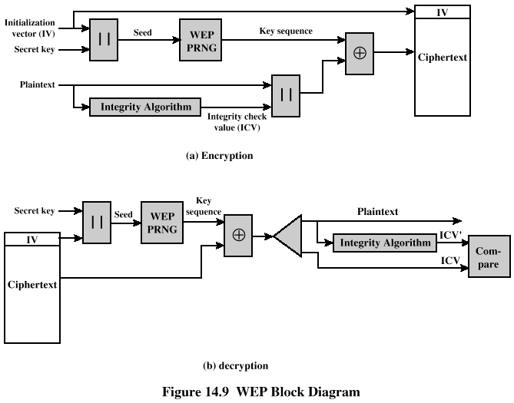
WEP algorithm

Slide 48
WEP algorithm (cont’d)
WEP is based on RC4 encryption, with an initialization vector (IV).
inadequate even with a 104-bit key (can be cracked), while the IV can be reproduced.

Slide 49
Wi-Fi Protected Access (WPA) and IEEE802.11i
To address the WLAN security issues, WPA, WPA-2 and IEEE802.11i are developed.
They have three main ingredients:
  Authentication: Extensible Authentication Protocol (EAP)
    A protocol involves exchanging authentication request and response between the user, AP, and the authentication server
  Access control: key managements, key caching
  Encryption: TKIP and AES
Figure 14.13

Slide 50
WPA and IEEE802.11i (cont’d)
TKIP – improved encryption.
  Each packets gets its own 48-bit serial number, which serves as part of the key and IV.
  Key is different for each packet, for each session/connection.
AES – advanced encryption (WPA-2)
  Block cipher that operates on blocks of data
  Key is different for each block

Slide 51
WPA, WPA2, and IEEE 802.11i
Security Type | WPA | WPA2 | 802.11i
Enterprise Mode | Authentication : EAP/802.1X | Authentication: EAP/802.1X | Authentication: EAP/802.1X
 | Encryption: TKIP | Encryption: AES | Encryption: AES
Personal Mode | Authentication: PSK (phase-shared key) | Authentication: PSK
 | Encryption: 128-bit RC4 w/TKIP | Encryption: AES | Encryption: AES
 | Ad-hoc not supported | Ad hoc not supported | Allowed ad hoc
Notes:
PSK – fixed/static key

